Slide 1
Detecting Fake Hotel Reviews using: - Natural Language Processing - Topic Modeling - Machine Classification
SpringBoard – Capstone 2
11/2/2017
Chris Gian
github.com/chrisgian

Slide 2
Roadmap
Motivation
Data
Data Preparation
Topic Modeling
Classification and Tuning
Results
Future steps

Slide 3


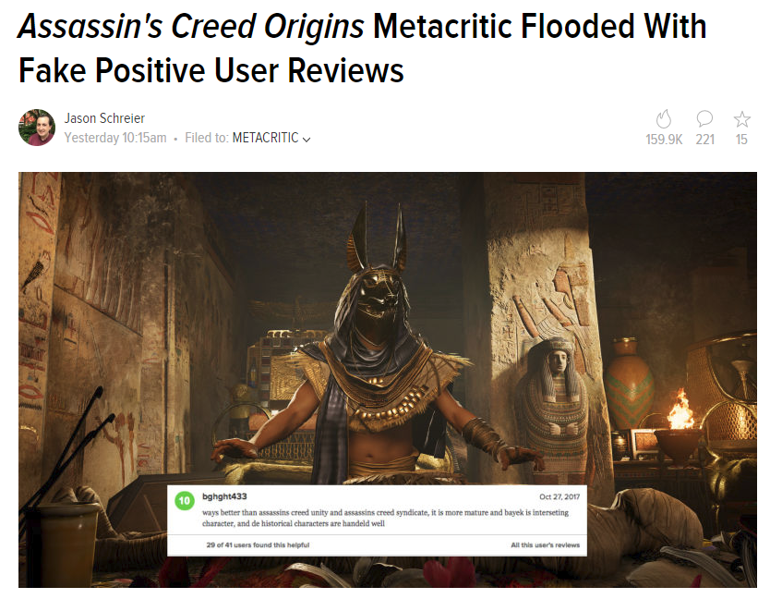
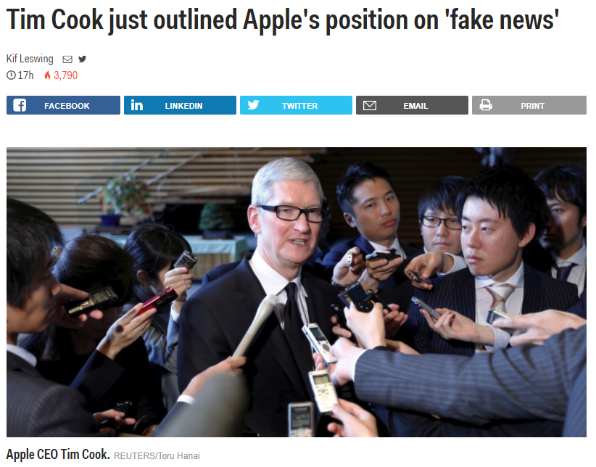


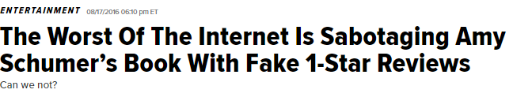
Motivation (1): Recent news

Slide 4
Motivation (2) Why + Approach
Why is this important to me?
Natural Language Processing (computational linguistics)
To extract, interpret, and translate information from one language into a form that can be stored, indexed, searched, and acted upon.

Slide 5


Motivation (3) Hypothetical Client
Client:
A Hotel Booking site.
Problem:
Users need reliable and honest hotel review information.
Solution:
Use NLP + Topic Modeling + Classification model to train a Spam Classifier
How was your experience at hotel X?
My experience was…
Submit
Warning! Danger Will Robinson! Spam!
Quarantine or block?

Slide 6
Motivation (4) Can you tell the difference?
 | Paid Reviewer | Real Reviewer
+ | the experince at the hard rock hotel in chicago was fantastic,i will rate them a 6 out of 5. they have wonderful service and great staff and the view is just wonderful. | I recently stayed at the Hard Rock Hotel in Chicago, Il. From the start, the experience was bad. The room was filthy, there were no towels, and the front desk did nothing to rectify the situation. I will never stay there again. I could not have been more dissatisfied.
- | The Swissotel Chicago is a very mediocre hotel, the service is always poor, and the room service food always comes cold, unless it's supposed to be cold than it comes warm. I would rather stay at a super 8 than this place again. | Uhhhhh, how do I know which direction to go in??? Stains on the carpet in the room. A big gauge in the wall, where maybe a thermostat once was??? The shower is decent. All in all, for the price they charge, NO THANKS!!! I'm just glad my company is footing the bill.

Slide 7
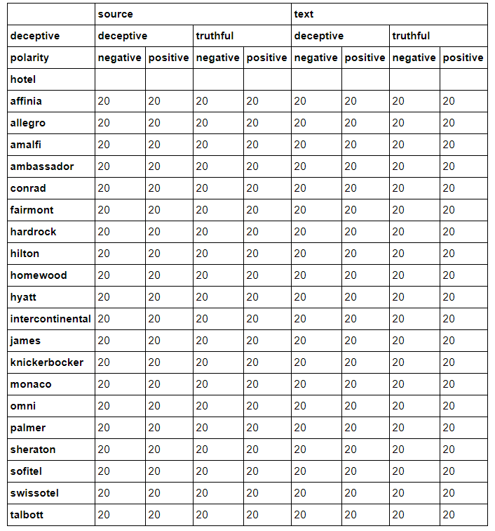
Data (2) Descriptives
A very balanced data set

Slide 8
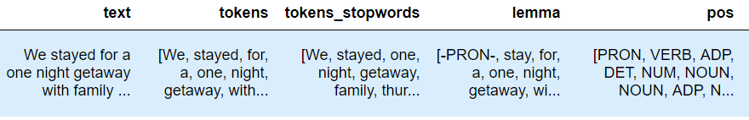
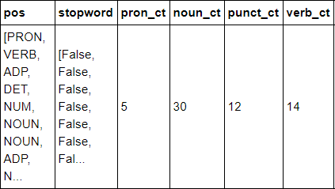
Data Preparation: Tokenizing
Sentence → Tokens → Parts of Speech
1
2
3
4
5
Parts of Speech → 4 Parts of Speech Variables

Slide 9
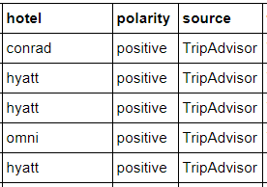
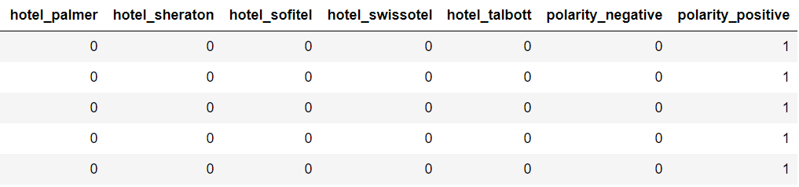
Data Preparation: Categorical Data
Categorical Data → Dummy Variables (22 Variables)

Slide 10
Topic Modeling
Latent Semantic Analysis:
Transform words used by reviewers into “groupings” – these are “topics”
Examples:
“Great family vacation”, “Terrible room service”, “No pets allowed”
Reduce into x “Topics”

Slide 11
Baseline Classification
6 Classification Models
Logistic Regression
Linear Discriminant Analysis (LDA)
K Nearest Neighbor Classification
Decision Trees
Naive Bayes (NB)
Support Vector Classifier (SVM)
Random Forest (RF)
Three sets of Features:
X1 = Topics Only (300 Variables)
X2 = Topics + Parts of Speech Metrics (300 + 4)
X3 = Topics + Parts of Speech Metrics + Dummy Variables (300 + 4 + 22)

Slide 12
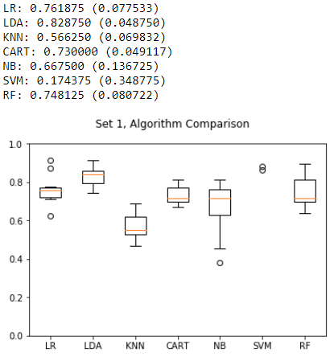
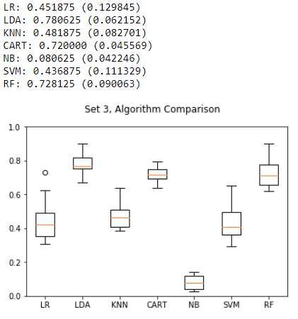
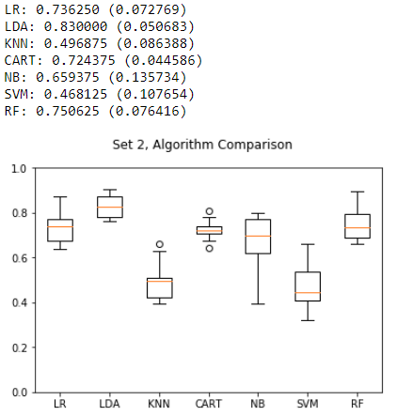
Model + Feature Selection (1)
Previous + Parts of Speech Metrics
Topics Only
Previous + Dummy Variables
LDA performs the best.

Slide 13

Going beyond baseline
Random Forest classifier because…
Many dimensions to data
Many parameters to be tuned
Bonus:
Does well with correlated variables
Easily get variable importance
“Forest” of models
=
100’s of Decision Tree models at random subsets of data

Slide 14
Results (1)
Best Accuracy: 84.6%
1.6 % improvement compared to LDA
+ 20% improvement compared to untuned Random Forest model
Best Model:
Max Tree Depth = 50
Minimum Samples per Node = 50
Gini Impurity
Of 322 variables, randomly select 18 per tree
1000 Decision Trees
10 folds cross validation
10,000
Decision
Tree Models

Slide 15
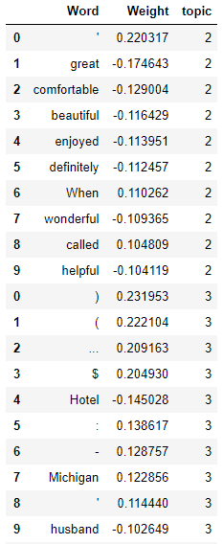
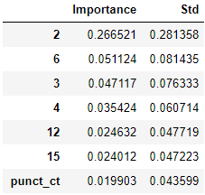
Results (2)
Mean Decrease in Impurity (MDI) tells us how important a variable is
Topic Vectors and 3 are most important
The use of punctuation is important

Slide 16
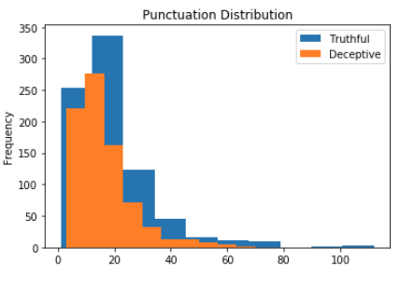
Results (3)
Descriptively, there is a noticeable difference in punctuation count between truthful and deceptive reviews.

Slide 17
Future steps
More data
Vary transformation steps
Screen predictors
Text Processing
Misspellings
Emojis
N-gram
More metadata
Time of post
User account data

